Slide 1
Data Analysis: Sales Prospects from Home Mortgage Data
TOPE ONILEIMO-AJAYI
temitopeajayi31@gmail.com

Slide 2
Statistical Inference
age of Borrower | Count of LTV | Average of borrower income ratio by age group
35 to 44 | 139 | 1.521244604
45 to 54 | 97 | 1.317835052
55 to 64 | 88 | 1.643495455
65 to 74 | 60 | 1.345438333
25 to 34 | 50 | 1.75473
< 25 | 47 | 1.850161702
> 74 | 19 | 1.291978947
Age of Borrower | 1 | #DIV/0!
(blank)
Grand Total | 501 | 1.5277572

Slide 3
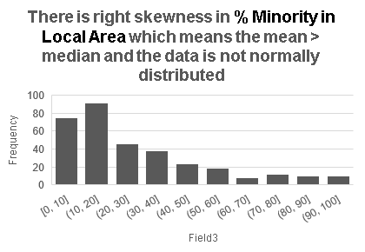
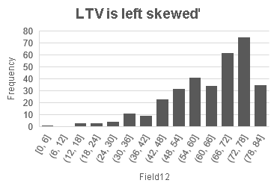
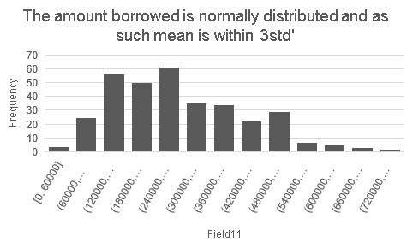
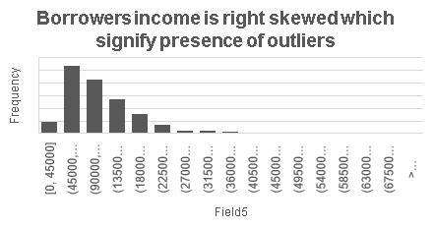
Statistical inference continue

Slide 4
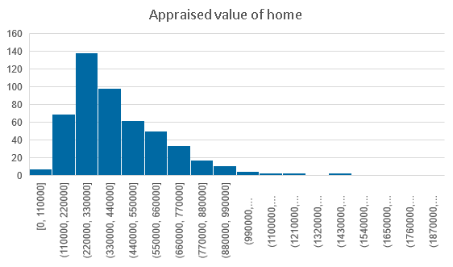
Statistical inference continue.
The appraised value of home is right skewed which means there is an outliers in the column and std is more than -3.

Slide 5
DATA ANALYSIS
Age of borrowers | Count of Borrower Annual Income | Sum of Field1
< 25 | 47 | 7863000
> 74 | 19 | 2078000
25 to 34 | 50 | 7004000
35 to 44 | 139 | 18004000
45 to 54 | 97 | 10523000
55 to 64 | 88 | 11839000
65 to 74 | 60 | 6502000
Grand Total | 500 | 63813000

Slide 6
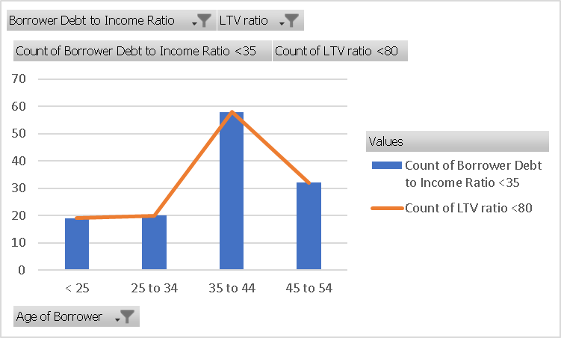
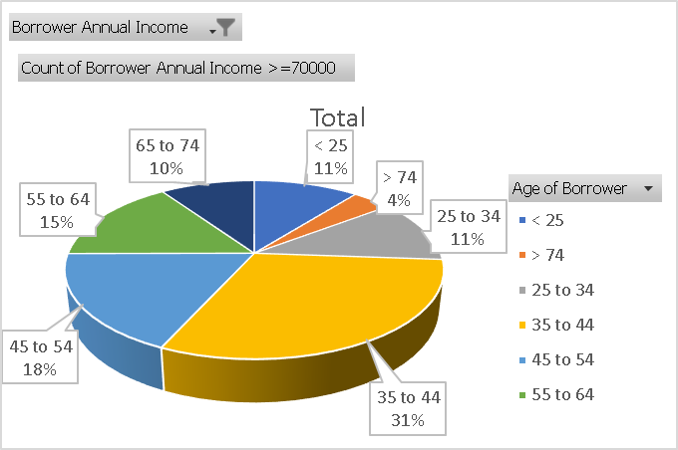
ANALYSIS CONTINUE

Slide 7
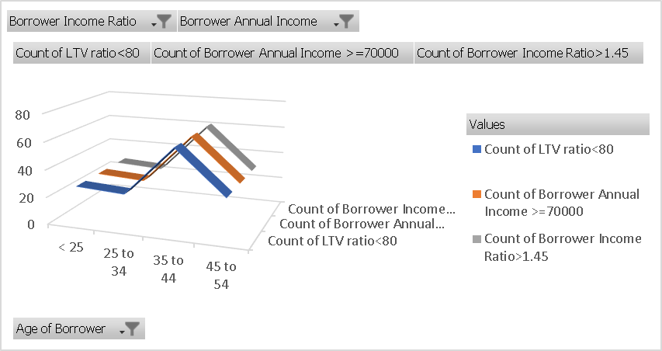
ANALYSIS CONTINUE
Age of borrowers | Count of % Minority in Local Area | Sum of Amount Borrowed | Count of LTV ratio | Count of Borrower Debt to Income Ratio | Count of Borrower Income Ratio | Count of Borrower Annual Income >=70000
< 25 | 21 | 8075000 | 21 | 21 | 21 | 21
25 to 34 | 11 | 4145000 | 11 | 11 | 11 | 11
35 to 44 | 28 | 9820000 | 28 | 28 | 28 | 28
45 to 54 | 22 | 6000000 | 22 | 22 | 22 | 22
Grand Total | 82 | 28040000 | 82 | 82 | 82 | 82

Slide 8
Observations and Key Insights
The total number of intending borrower is 500
With LTV set at <80%, the count of borrowers dropped to 332, the age group of 35- 44 has the highest number of borrower, also this age group has the highest borrowing at 15080000
The total number of borrower at LTV <80 drops to 228 when age group >74, 65-74 and 55-65 were filter out this was done because the borrowers were opting for 360months which is equivalent to 30years, we assumed the source of income for this age group would have dropped.
182 borrowers, 29% of age group 35-44 which is majority falls within Counts of % Minority in Local Area >25%
% Minority in Local Area >25, Borrower Annual Income >70000, Borrower Income Ratio >1.45, Borrower Debt to Income Ratio<35, LTV ratio and Length of Mortgage in Months are the conditions considered for borrowers

Slide 9
Observations and Key Insights Continues
82 borrowers fit into those categories majority not being a first-time buyer. This combination has the least risk and most leads.
Age group 35-44 has the highest number of borrowers(28) with group 25-34 the least with 11 borrowers
The grand total money to be borrowed is 28040000

